Slide 1
Ethereum 2.0 Projects
Proof-of-stake (Beacon Chain, Casper FFG)
Sharding
eWASM

Slide 2
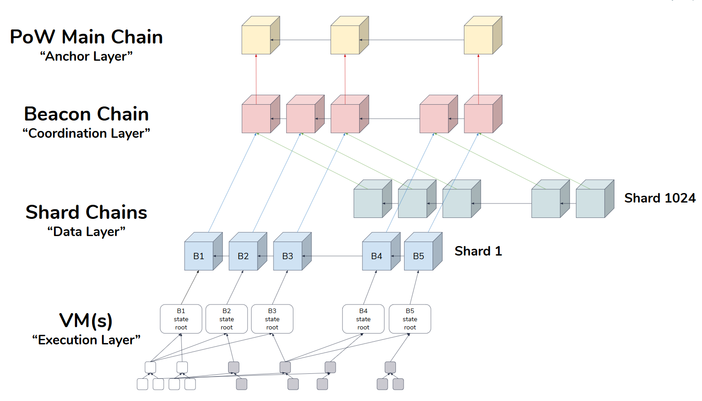
Structure of Ethereum 2.0

Slide 3
Structure of Ethereum 2.0
PoW Main Chain : Is the blockchain we know today, the current Ethereum mainnet. In the Ethereum 2.0 system this layer will continue to operate mainly as today.
Beacon Chain : It will be the full PoS layer of coordination of the entire underlying structure.
Shard Chains : The shard chains will be the layer in which the transactions are aggregated to reach a consensus on their order.
VM (s) : The VM layer will be used for the execution of contracts and transactions

Slide 4
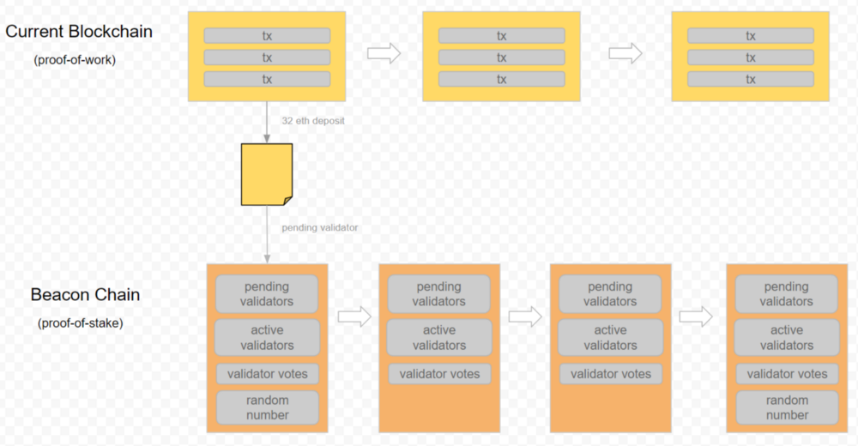
Beacon Chain

Slide 5
Beacon Chain
Validators can participate by depositing exactly 32 eth
Each validators will vote off-chain by sending their signature. Here they use the concept of aggregate signature where petition is sent to each validator, who applies their signature in support and later incorporated into the blockchain when the petition has enough support.
The more validators that can participate the better because it improves security and decentralisation.
With aggregate signatures, many more validators can participate in the proof-of-stake protocol. System can support a up to 2²² validators.

Slide 6
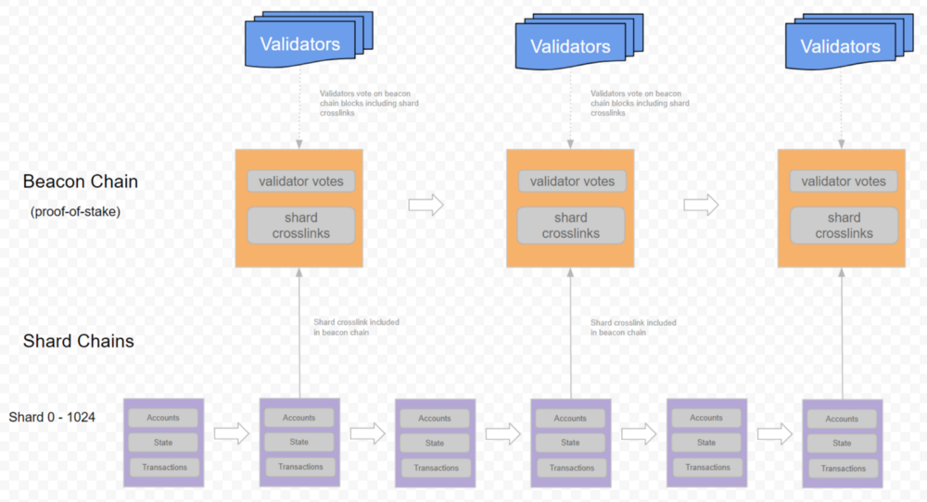
Sharding

Slide 7
Sharding
Basically right now all the transactions are going through one blockchain they are all verified transactions on one chain in a sequence.
These transactions cannot be processed in parallel, despite being run on thousands of machines.
Sharding will allow you to split each Ethereum into about thousand different shards that are kind of like their own mini Ethereums they're having own shorted chains which are going to have their own States their own code etc.
They all share the same proof-of-stake consensus with the beacon chain.
The registered validators on the beacon chain will become a global pool of validators, that validate blocks of transactions on the beacon chain and the shards.
It is expected that a sharded Ethereum will be able to process more than 15,000 transactions per second.

Slide 8
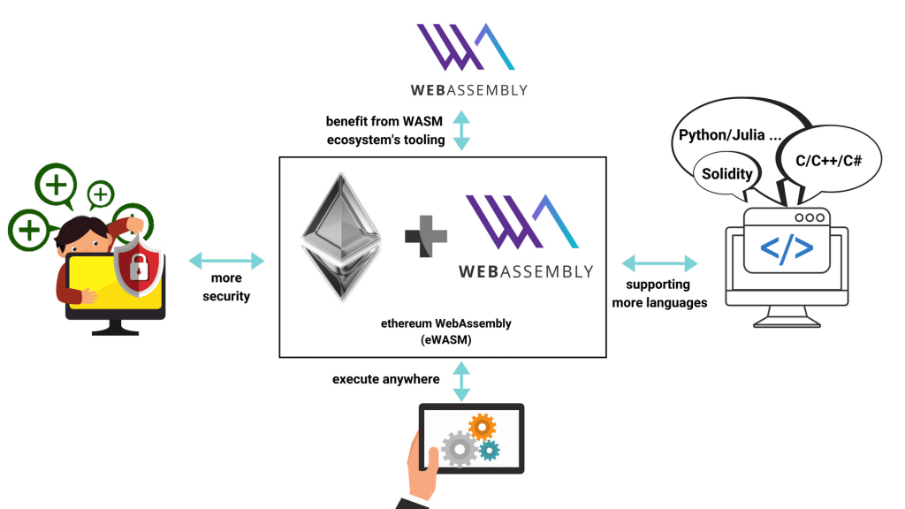
eWASM

Slide 9
eWASM
The Ethereum Virtual Machine (EVM) is itself becoming a performance bottleneck;
Even the speed with which the EVM can run is causing issues so for that reason they created the solution which is the eWASM.
eWASM (Web Assembly) is being developed as a replacement to the EVM.
It is a binary code that you can use to compile your code for the Web.
The Ethereum shards will not use the existing EVM but will jump straight to using eWASM. Compilers will be developed that convert Solidity and Vyper into the new eWASM instruction-set.
eWASM will make a significant difference to how many transactions can be processed and subsequently added to a block — further increasing transaction throughput.

